Slide 1
Constraint Satisfaction Problem
Md Mehrab Hossain Opi
CSE 4109: Artificial Intelligence

Slide 2
Introduction
In traditional search we treated each state as black box with no internal structure.
Each state was atomic or indivisible.
Today we will use a factored representation for each state.
A set of variables, each of which has a value.
A problem is solved when each variable has a value that satisfies all the constraints on the variable.
A problem described this way is called a constraint satisfaction problem or CSP.

Slide 3
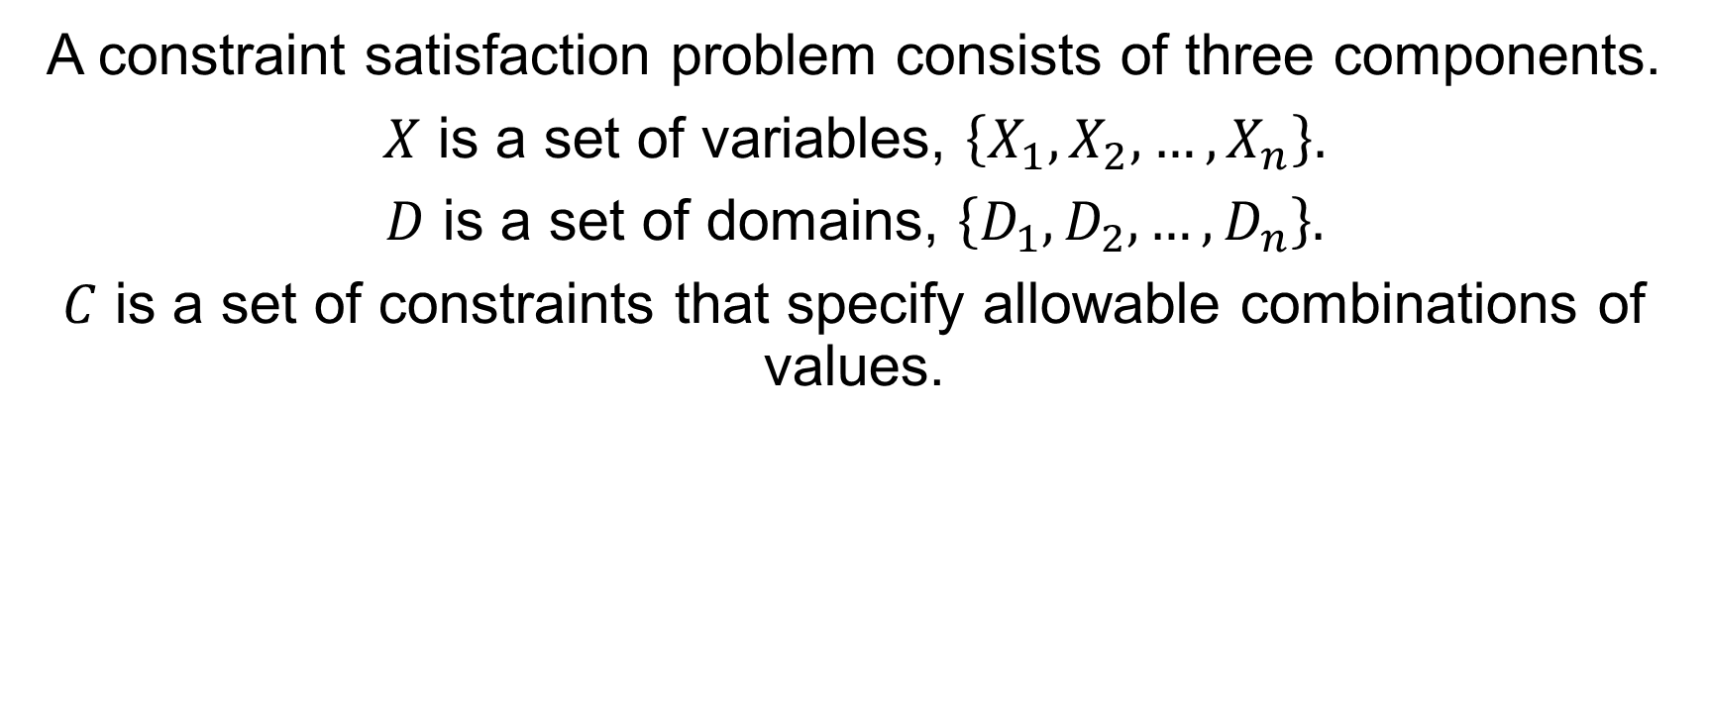
Definition
A constraint satisfaction problem consists of three components.
$X$ is a set of variables, $\left\{X_{1},X_{2},…,X_{n}\right\}.$
$D$ is a set of domains, $\left\{D_{1},D_{2},…, D_{n}\right\}.$
$C$ is a set of constraints that specify allowable combinations of values.

Slide 4
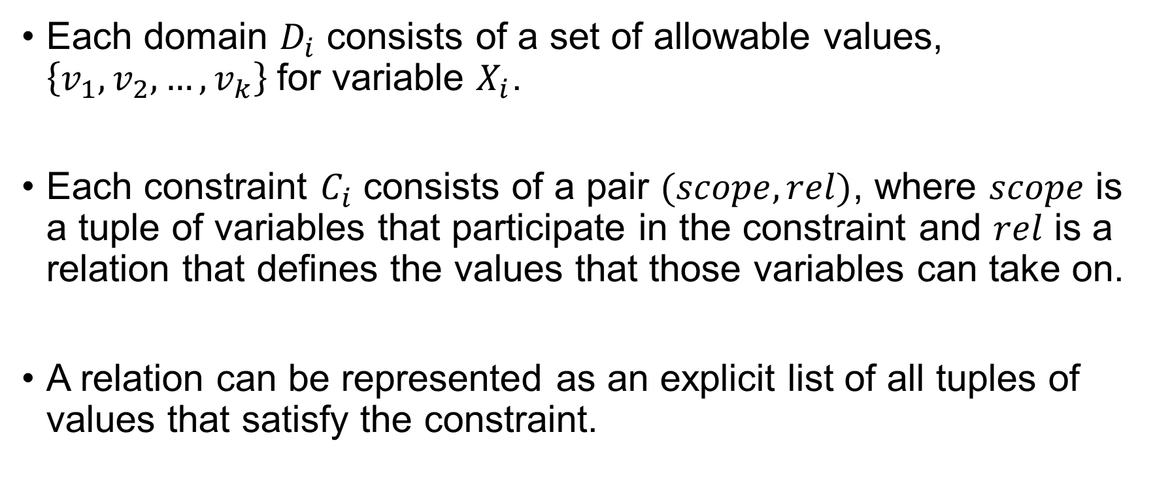
Definition
Each domain $D_{i}$ consists of a set of allowable values, $\left\{v_{1},v_{2},…, v_{k}\right\}$for variable $X_{i}$.
Each constraint $C_{i}$ consists of a pair $(scope, rel)$, where $scope$ is a tuple of variables that participate in the constraint and $rel$ is a relation that defines the values that those variables can take on.
A relation can be represented as an explicit list of all tuples of values that satisfy the constraint.

Slide 5
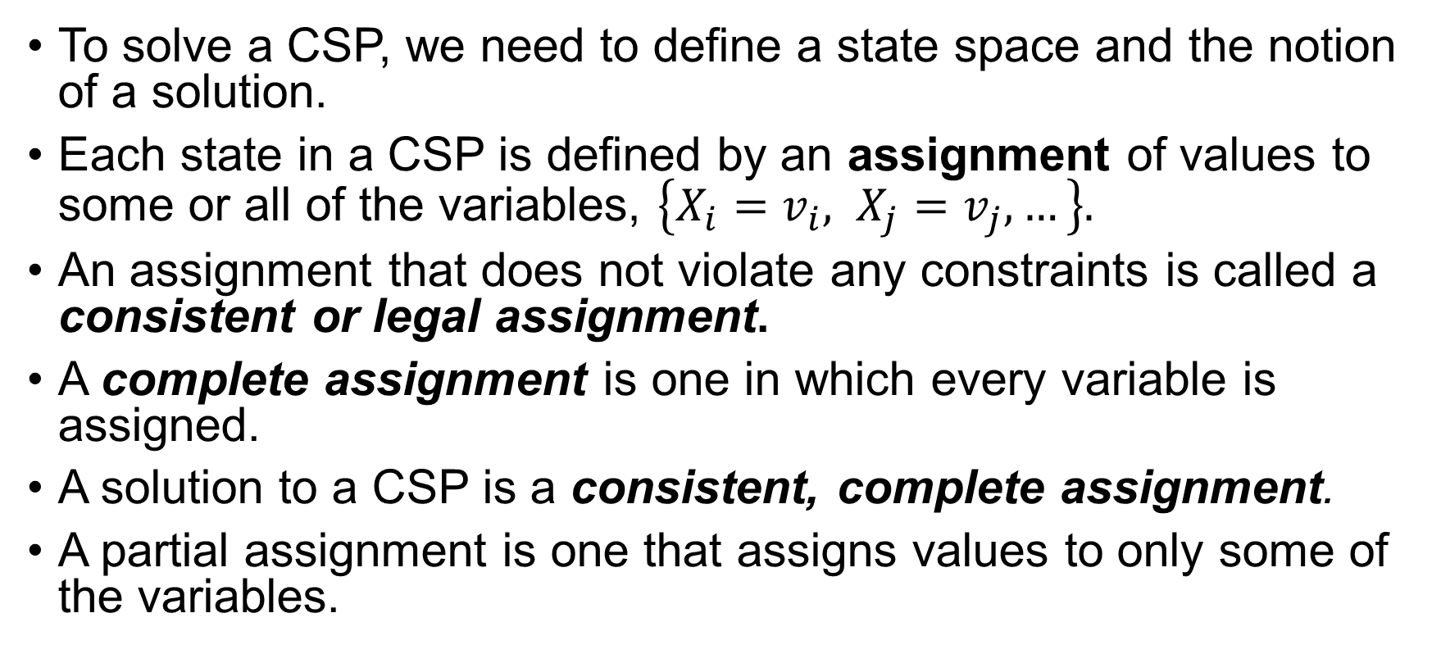
Definition
To solve a CSP, we need to define a state space and the notion of a solution.
Each state in a CSP is defined by an assignment of values to some or all of the variables, $\left\{X_{i}=v_{i}, X_{j}=v_{j}, …\right\}.$
An assignment that does not violate any constraints is called a consistent or legal assignment.
A complete assignment is one in which every variable is assigned.
A solution to a CSP is a consistent, complete assignment.
A partial assignment is one that assigns values to only some of the variables.

Slide 6
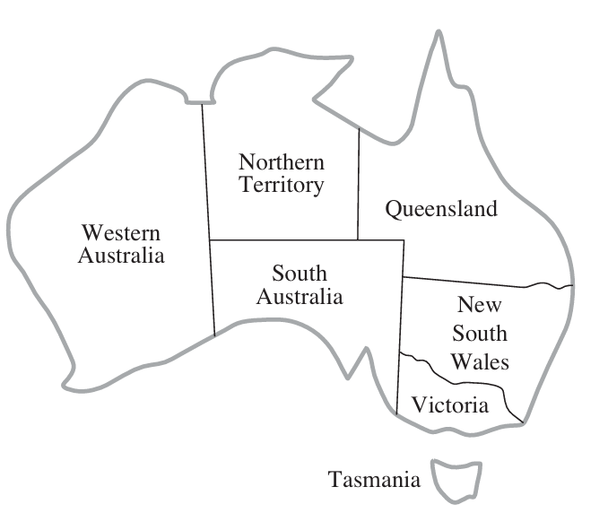
Map Coloring Problem
Consider the following map
We need to color each region either red, green, or blue in such a way that no neighboring regions have the same color.

Slide 7

Map Coloring Problem
To formulate this as a CSP, we define the variables to be the region. $X=\left\{\begin{aligned}WA, NT, Q, \\ NSW, V, SA, T\end{aligned}\right\}.$
The domain of each variable is the set $D_{i}=\left\{red, green, blue\right\}.$

Slide 8
Map Coloring Problem
The constraints require neighboring regions to have distinct colors.
There are nine places where regions border.
We get nine constraints.

Slide 9
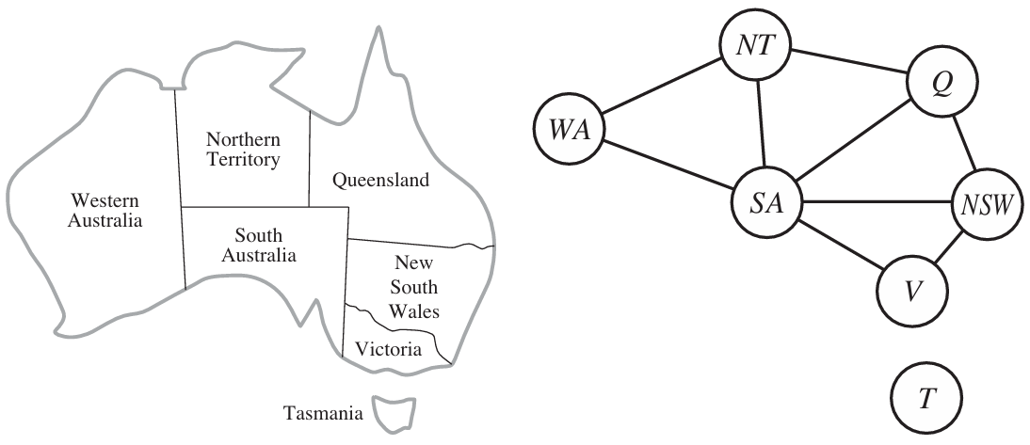

Map Coloring Problem
$$C=\{SA≠WA, SA≠NT, SA≠Q, SA≠NSW, SA≠V, WA≠NT, NT≠Q, Q≠NSW, NSW≠V\}$$

Slide 10

Map Coloring Problem
$SA≠WA$ is the shortcut for $⟨\left(SA, WA\right), SA≠WA⟩$.

Slide 11

Map Coloring Problem
One possible solution is
$$\{WA=red, NT=green , Q=red, NSW=green, V=red, SA=blue, T=red\}$$

Slide 12
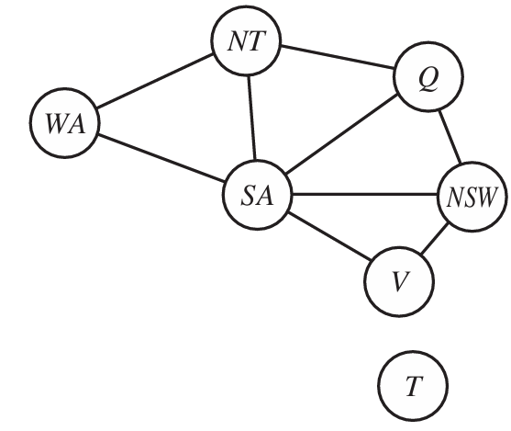
Map Coloring Problem
We can visualize a CSP as a constraint graph.
The nodes correspond to variables.
The edges connects any two variable that
participate in a constraint.

Slide 13
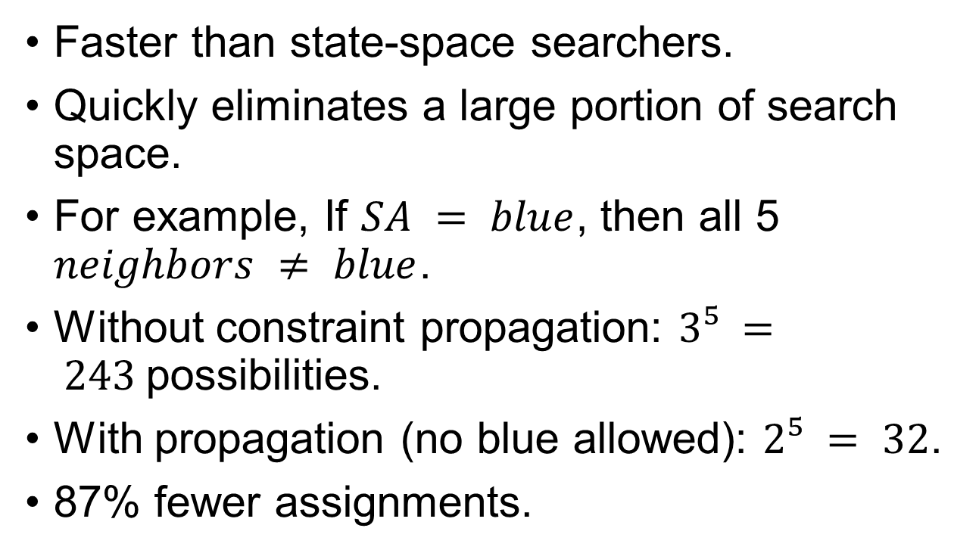
Why CSP?
Faster than state-space searchers.
Quickly eliminates a large portion of search space.
For example, If $SA = blue$, then all 5 $neighbors ≠ blue$.
Without constraint propagation: $3⁵ = 243$possibilities.
With propagation (no blue allowed): $2⁵ = 32$.
87% fewer assignments.

Slide 14
Job-shop Scheduling
Consider the problem of scheduling the assembly of a car.
The whole job is composed of tasks.
We can model each task as a variable.
Value of each variable is the time that the task starts.
Expressed as an integer number of minutes.

Slide 15
Job-shop Scheduling
Constraints can assert that one task must occur before another.
Only so many tasks can go on at once.
Also specify that a task takes a certain amount of time to complete.

Slide 16
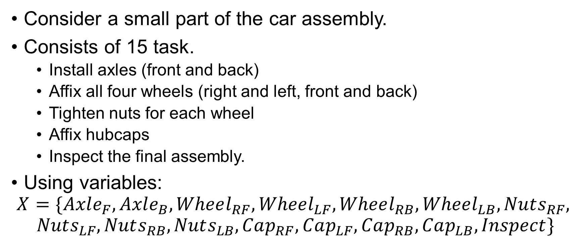
Job-shop Scheduling
Consider a small part of the car assembly.
Consists of 15 task.
Install axles (front and back)
Affix all four wheels (right and left, front and back)
Tighten nuts for each wheel
Affix hubcaps
Inspect the final assembly.
Using variables:
$$X=\{Axle_{F}, Axle_{B}, Wheel_{RF}, Wheel_{LF}, Wheel_{RB}, Wheel_{LB}, Nuts_{RF},$$
$$Nuts_{LF}, Nuts_{RB}, Nuts_{LB}, Cap_{RF}, Cap_{LF}, Cap_{RB}, Cap_{LB}, Inspect\}$$

Slide 17
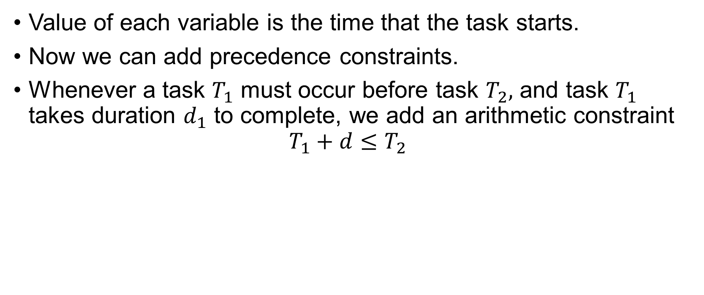
Job-shop Scheduling
Value of each variable is the time that the task starts.
Now we can add precedence constraints.
Whenever a task $T_{1}$ must occur before task $T_{2},$ and task $T_{1}$ takes duration $d_{1}$ to complete, we add an arithmetic constraint $T_{1}+d≤T_{2}$

Slide 18
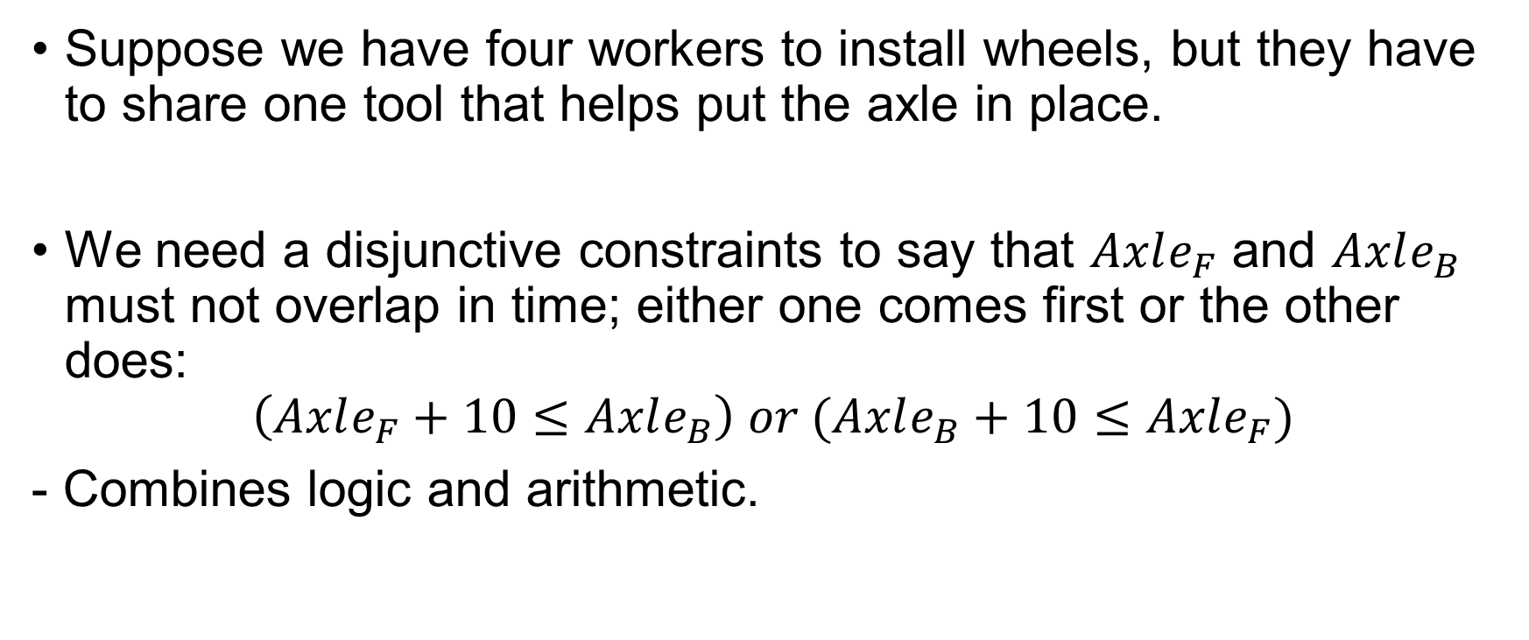
Job-shop Scheduling
Suppose we have four workers to install wheels, but they have to share one tool that helps put the axle in place.
We need a disjunctive constraints to say that $Axle_{F}$ and $Axle_{B}$ must not overlap in time; either one comes first or the other does:
$$\left(Axle_{F}+10≤Axle_{B}\right) or (Axle_{B}+10≤Axle_{F})$$
- Combines logic and arithmetic.

Slide 19
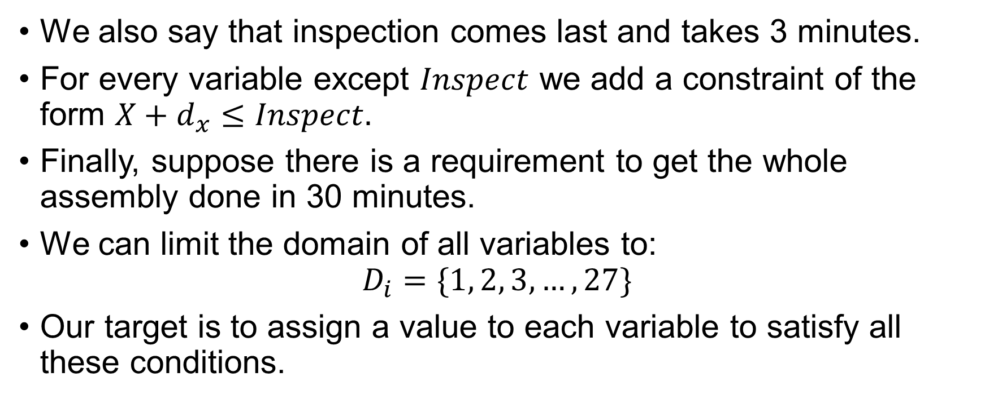
Job-Shop Scheduling
We also say that inspection comes last and takes 3 minutes.
For every variable except $Inspect$ we add a constraint of the form $X+d_{x}≤Inspect.$
Finally, suppose there is a requirement to get the whole assembly done in 30 minutes.
We can limit the domain of all variables to: $D_{i}=\{1, 2, 3, …, 27\}$
Our target is to assign a value to each variable to satisfy all these conditions.

Slide 20
Inference in CSP
In regular state-space search, an algorithm can do only one thing. – search.
In CSP there is a choice.
Search.
Choose a new variable assignment from several possibilities.
Do a specific type of inference called constraint propagation.
Constraint propagation can run before or during search.
Sometimes it even solves the problem entirely.

Slide 21
Local Consistency
Local consistency prunes inconsistent values from the graph.
Variables are represented as nodes, and binary constraints as arcs.
Enforcing consistency checks each part of the graph to eliminate invalid values.
There are different types of local consistency, like node, arc, and path consistency.
This process reduces the search space, sometimes dramatically.

Slide 22
Node Consistency
A variable is node-consistent if all its values satisfy unary constraints.
Example: SA = {red, green, blue},
But SA dislikes green → reduced to {red, blue}.
A network is node-consistent if every variable is node-consistent.
Running node consistency eliminates all unary constraints.

Slide 23
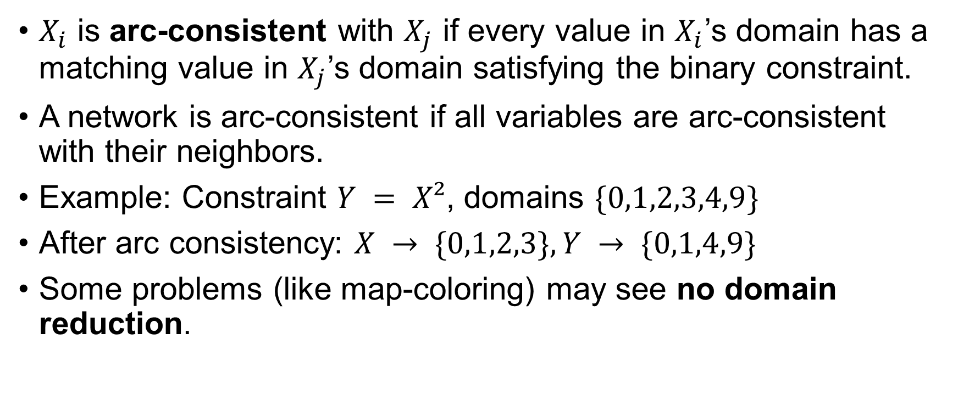
Arc Consistency
$X_{i}$ is arc-consistent with $X_{j}$ if every value in $X_{i}$’s domain has a matching value in $X_{j}$’s domain satisfying the binary constraint.
A network is arc-consistent if all variables are arc-consistent with their neighbors.
Example: Constraint $Y = X²$, domains $\{0,1,2,3,4,9\}$
After arc consistency: $X → \{0,1,2,3\}, Y → \{0,1,4,9\}$
Some problems (like map-coloring) may see no domain reduction.

Slide 24
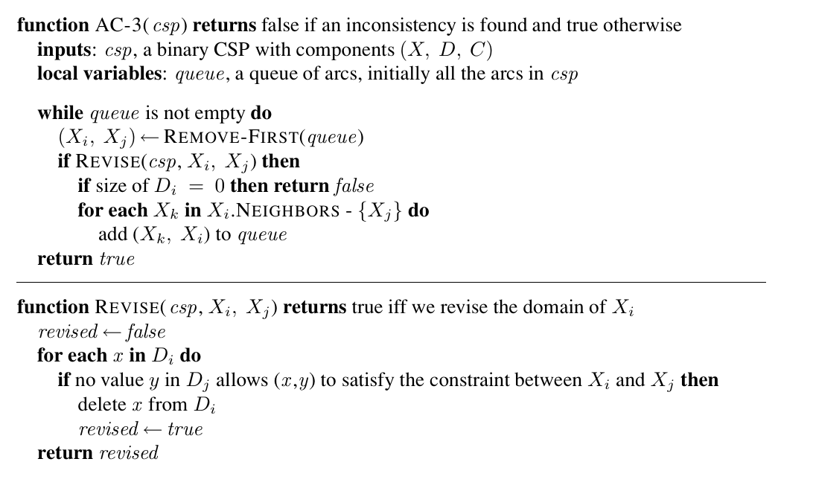
Arc Consistency – AC-3 Algorithm

Slide 25
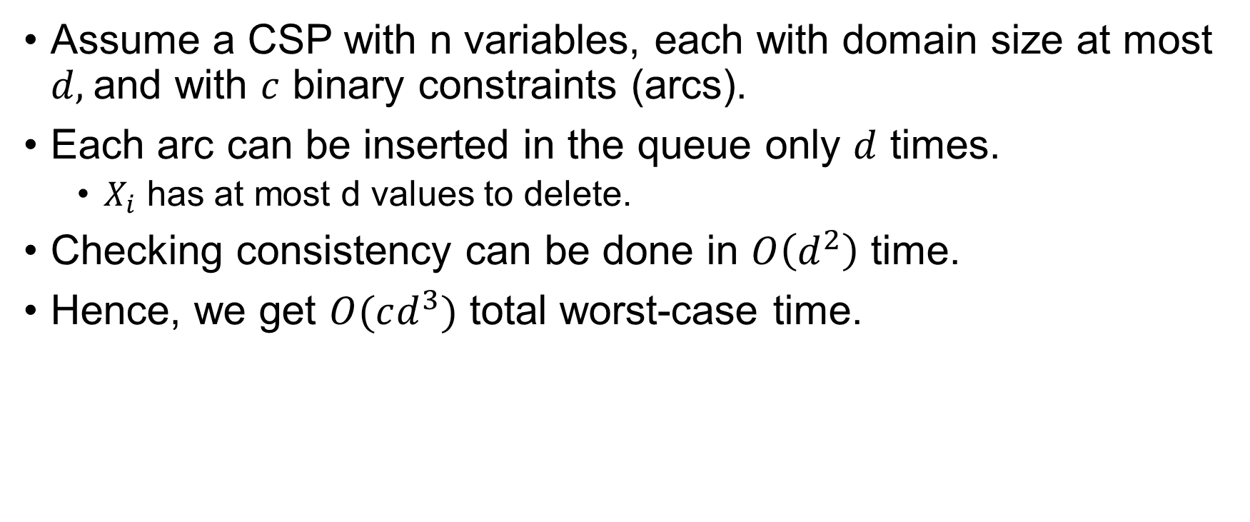
Arc Consistency – AC-3 Algorithm
Assume a CSP with n variables, each with domain size at most $d,$and with $c$ binary constraints (arcs).
Each arc can be inserted in the queue only $d$ times.
$X_{i}$ has at most d values to delete.
Checking consistency can be done in $O\left(d^{2}\right)$ time.
Hence, we get $O(cd^{3})$ total worst-case time.

Slide 26
Path Consistency
Arc consistency reduces domains and can sometimes:
Solve the CSP (all domains size 1)
Detect failure (some domain size 0)
Some networks remain unresolved:
Australia map-coloring with 2 colors
Every variable is already arc-consistent
WA, NT, SA all touch → need ≥3 colors

Slide 27
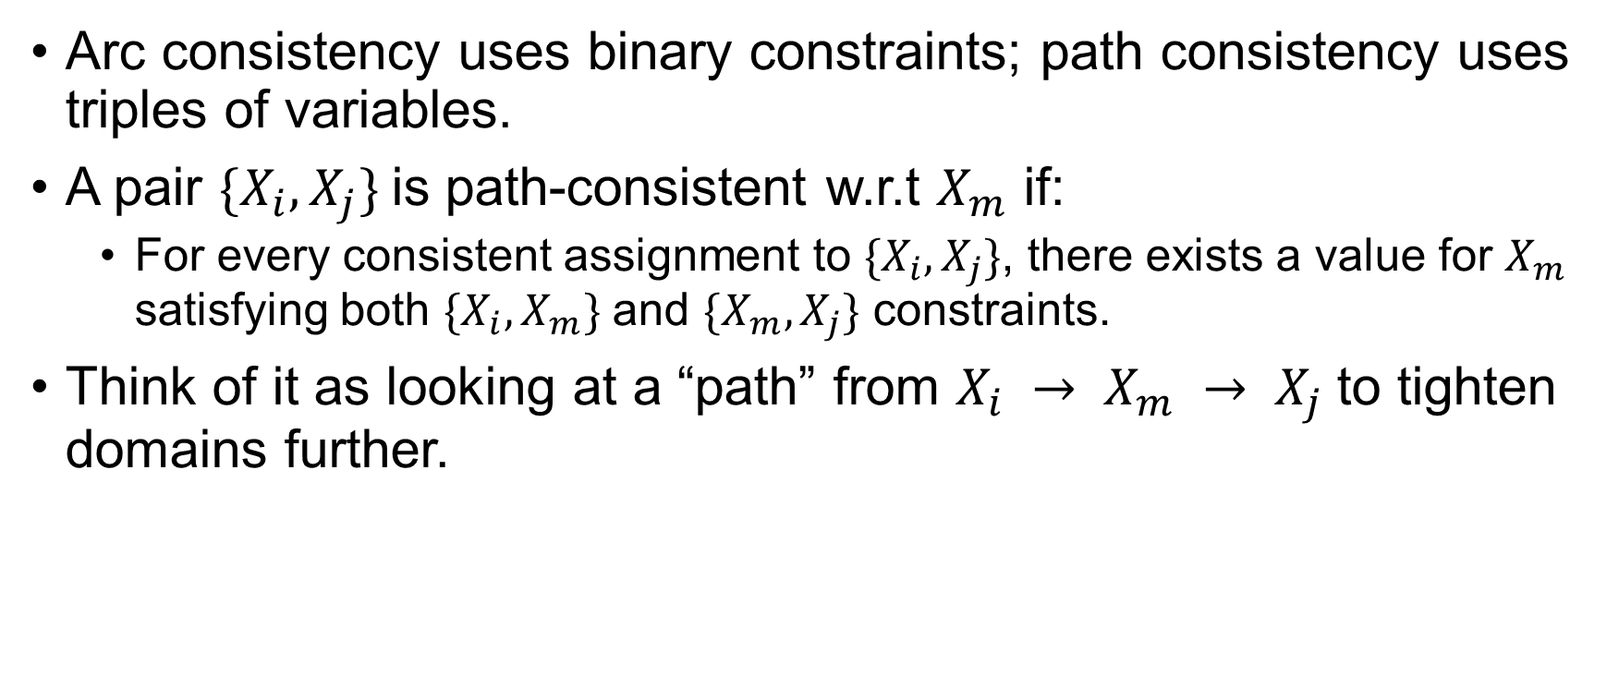
Path Consistency
Arc consistency uses binary constraints; path consistency uses triples of variables.
A pair $\{X_{i}, X_{j}\}$is path-consistent w.r.t $X_{m}$ if:
For every consistent assignment to $\{X_{i}, X_{j}\}$, there exists a value for $X_{m}$ satisfying both $\{X_{i}, X_{m}\}$ and $\{X_{m}, X_{j}\}$ constraints.
Think of it as looking at a “path” from $X_{i} → X_{m} → X_{j}$to tighten domains further.

Slide 28
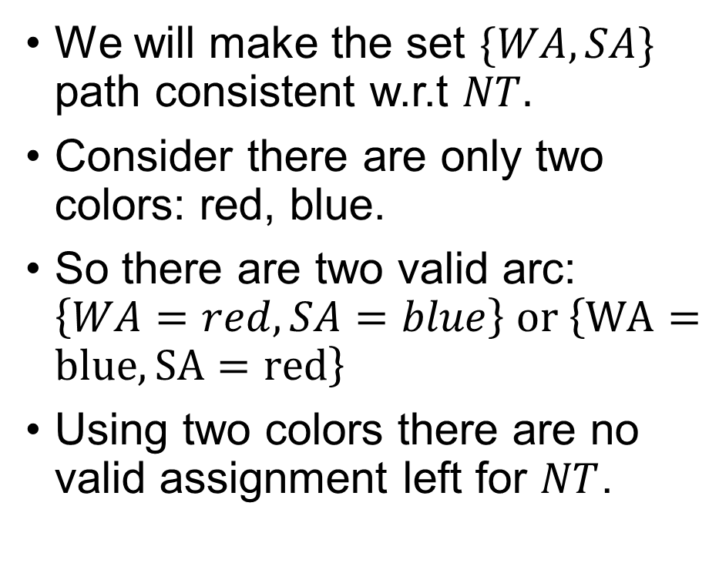
Path Consistency
We will make the set $\{WA, SA\}$ path consistent w.r.t $NT.$
Consider there are only two colors: red, blue.
So there are two valid arc: $\left\{WA=red, SA=blue\right\} or \left\{WA=blue, SA=red\right\}$
Using two colors there are no valid assignment left for $NT$.

Slide 29
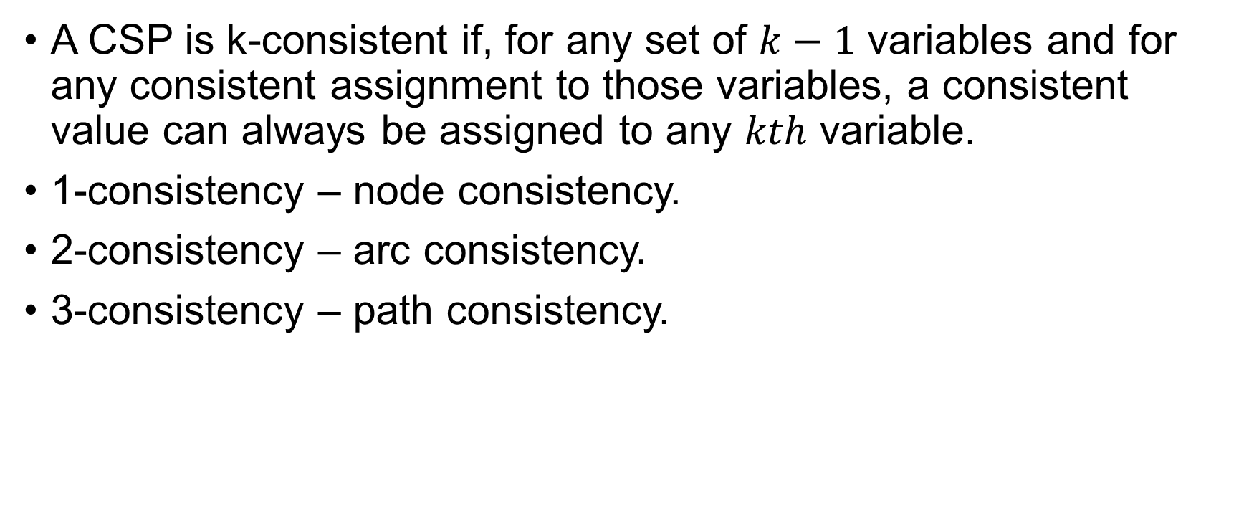
K-consistency
A CSP is k-consistent if, for any set of $k−1$ variables and for any consistent assignment to those variables, a consistent value can always be assigned to any $kth$ variable.
1-consistency – node consistency.
2-consistency – arc consistency.
3-consistency – path consistency.

Slide 30

K-consistency
A CSP is strongly k-consistent if it is k-consistent and is also $(k−1)$ consistent, $(k−2)$-consistent, … and all the way down to 1-consistent.

Slide 31

Global Constraints
Global constraint is one involving an arbitrary number of variables.
Not necessarily all variables.
$Alldiff$ constraint says that all the variables involved must have distinct values.

Slide 32
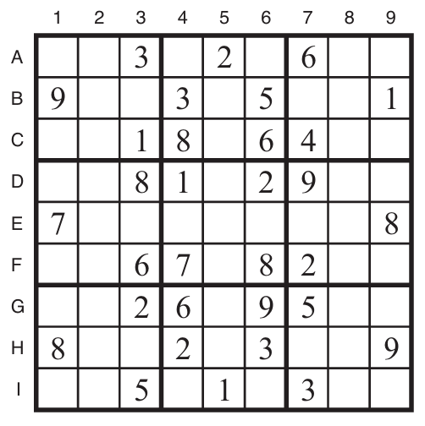
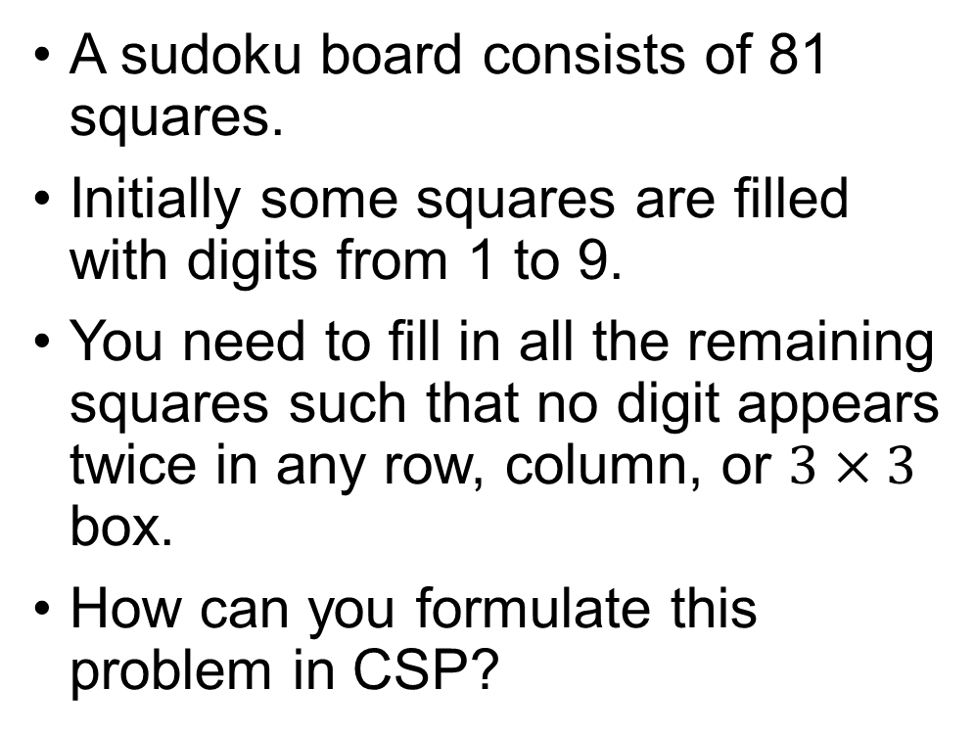
Sudoku Example
A sudoku board consists of 81 squares.
Initially some squares are filled with digits from 1 to 9.
You need to fill in all the remaining squares such that no digit appears twice in any row, column, or $3×3$ box.
How can you formulate this problem in CSP?

Slide 33

Sudoku Example
There are 81 variables – one for each square.
We use the variable names $A1$ … $I9$.
Domain of each empty squares $\left\{1, 2, 3, 4, 5, 6, 7, 8, 9\right\}$
Prefilled squares have a domain consisting of a single value.

Slide 34
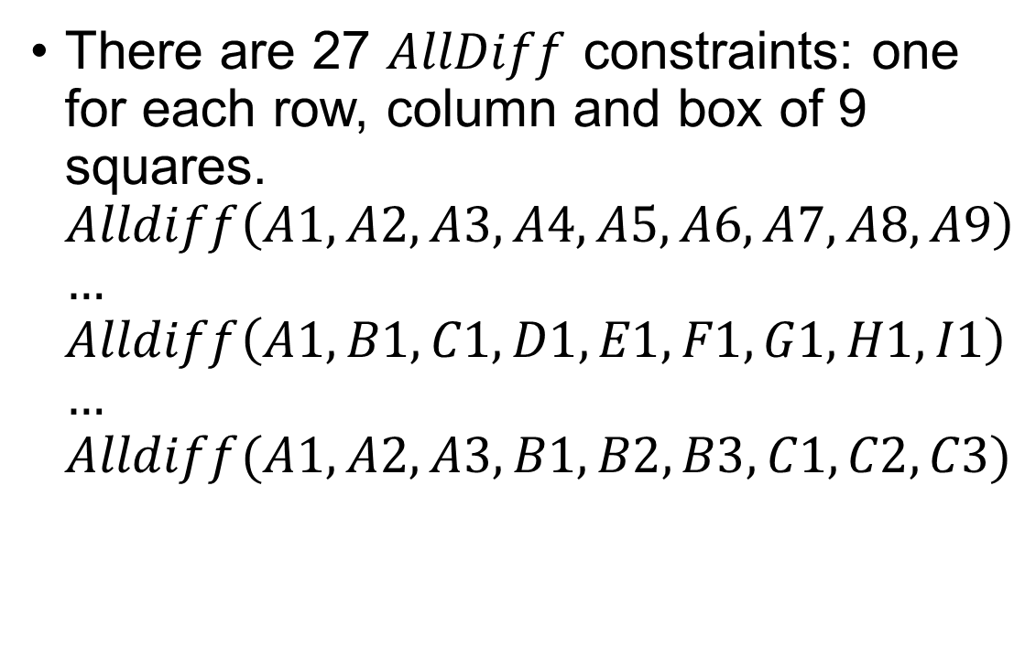
Sudoku Example
There are 27 $AllDiff$ constraints: one for each row, column and box of 9 squares. $Alldiff\left(A1, A2, A3, A4, A5, A6, A7, A8, A9\right)$ $…$ $Alldiff\left(A1, B1, C1, D1, E1, F1, G1, H1, I1\right)$ $…$ $Alldiff(A1, A2, A3, B1, B2, B3, C1, C2, C3)$

Slide 35
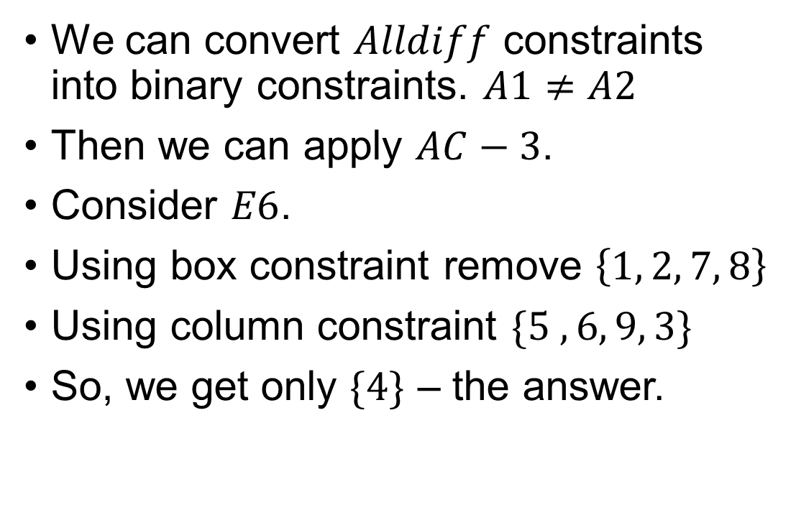
Sudoku Example
We can convert $Alldiff$ constraints into binary constraints. $A1≠A2$
Then we can apply $AC−3$.
Consider $E6$.
Using box constraint remove $\left\{1, 2, 7, 8\right\}$
Using column constraint $\{5 ,6, 9, 3\}$
So, we get only $\{4\}$ – the answer.

Slide 36
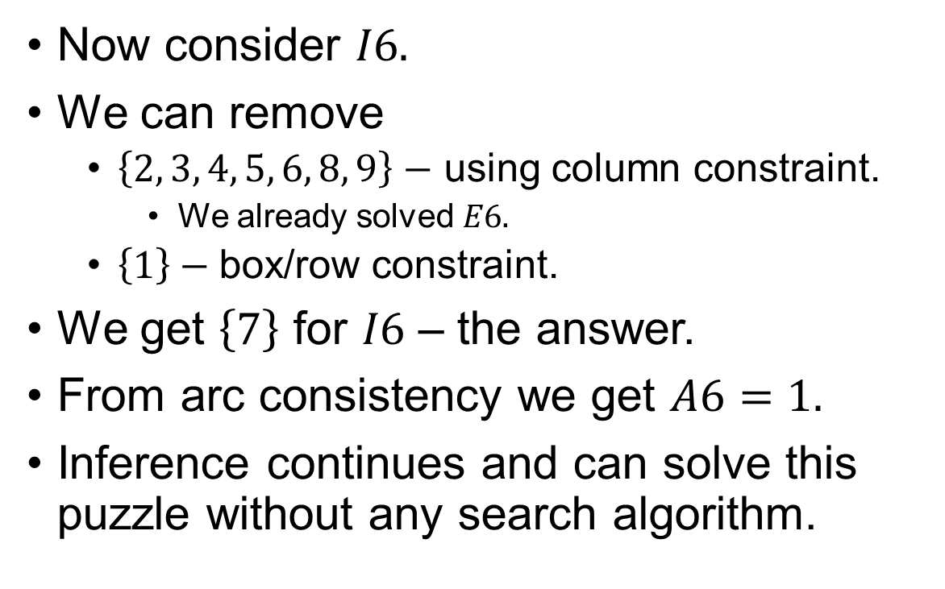
Sudoku Example
Now consider $I6.$
We can remove
$\left\{2, 3, 4, 5, 6, 8, 9\right\}−$ using column constraint.
We already solved $E6.$
$\left\{1\right\}−$box/row constraint.
We get $\left\{7\right\}$ for $I6$ – the answer.
From arc consistency we get $A6=1.$
Inference continues and can solve this puzzle without any search algorithm.

Slide 37

Sudoku Example
Of course, not all sudoku example can be solved using arc consistency.
Slightly harder ones can be solved using $PC−2$.
To solve the hardest, we need better strategy.

Slide 38
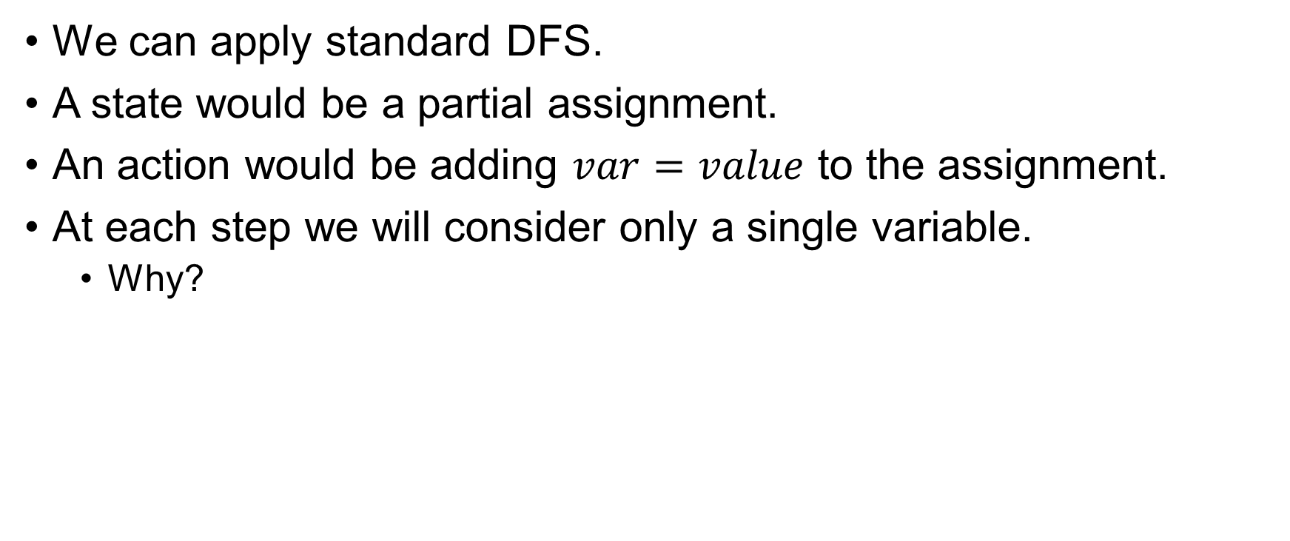
Backtracking Search for CSPs
We can apply standard DFS.
A state would be a partial assignment.
An action would be adding $var=value$ to the assignment.
At each step we will consider only a single variable.
Why?

Slide 39
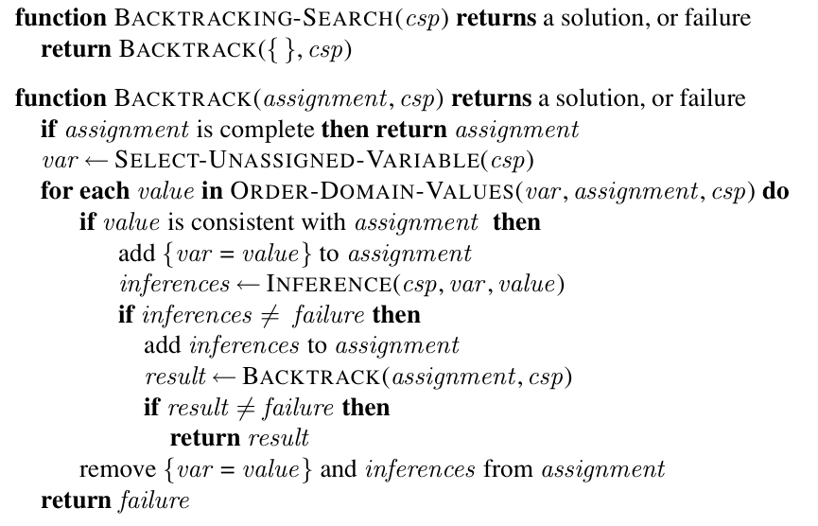
Backtracking Search for CSPs

Slide 40
Backtracking Search for CSPs
Earlier we used heuristic functions derived from our knowledge.
We can solve CSPs efficiently without such domain-specific knowledge.
Instead, we can add some sophistication to the unspecified functions.

Slide 41
Backtracking Search for CSPs
How to Avoid Repeated Failure?

Slide 42
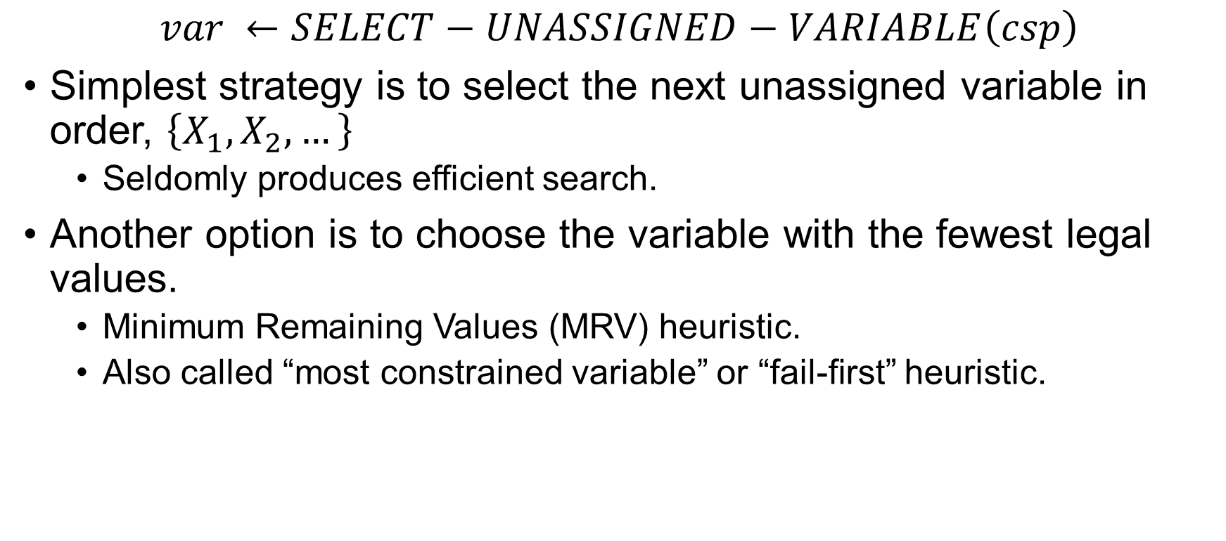
Variable and Value Ordering
$$var ←SELECT−UNASSIGNED−VARIABLE\left(csp\right)$$
Simplest strategy is to select the next unassigned variable in order, $\left\{X_{1}, X_{2}, …\right\}$
Seldomly produces efficient search.
Another option is to choose the variable with the fewest legal values.
Minimum Remaining Values (MRV) heuristic.
Also called “most constrained variable” or “fail-first” heuristic.

Slide 43
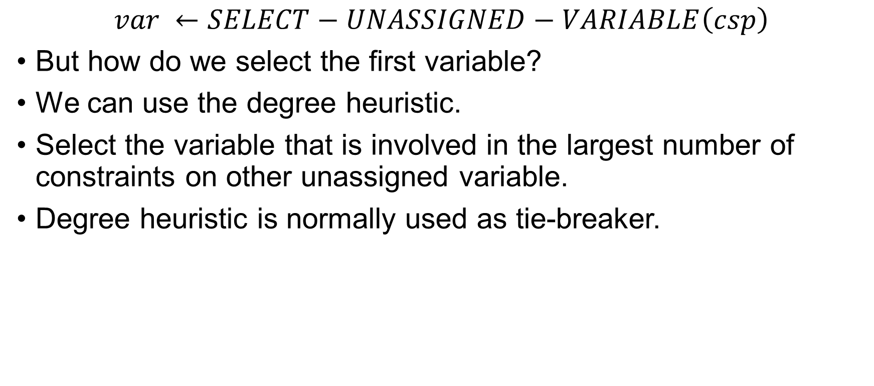
Variable and Value Ordering
$$var ←SELECT−UNASSIGNED−VARIABLE\left(csp\right)$$
But how do we select the first variable?
We can use the degree heuristic.
Select the variable that is involved in the largest number of constraints on other unassigned variable.
Degree heuristic is normally used as tie-breaker.

Slide 44
Variable and Value Ordering
Once a variable is chosen, we need to select the order of value to assign.
We can use the least-constraining –value heuristic.
Use the value that rules out the fewest choices for neighbouring variables.
Why should variable selection be fail-first, but value selection be fail-last?

Slide 45
Interleaving search and inference
One of the simplest forms of inference in called forward checking.
Whenever a variable X is assigned, the forward-checking process establishes arc consistency for it.
For any node Y connected with node X, delete from Y’s domain any value that is inconsistent with the value chosen for X.

Slide 46
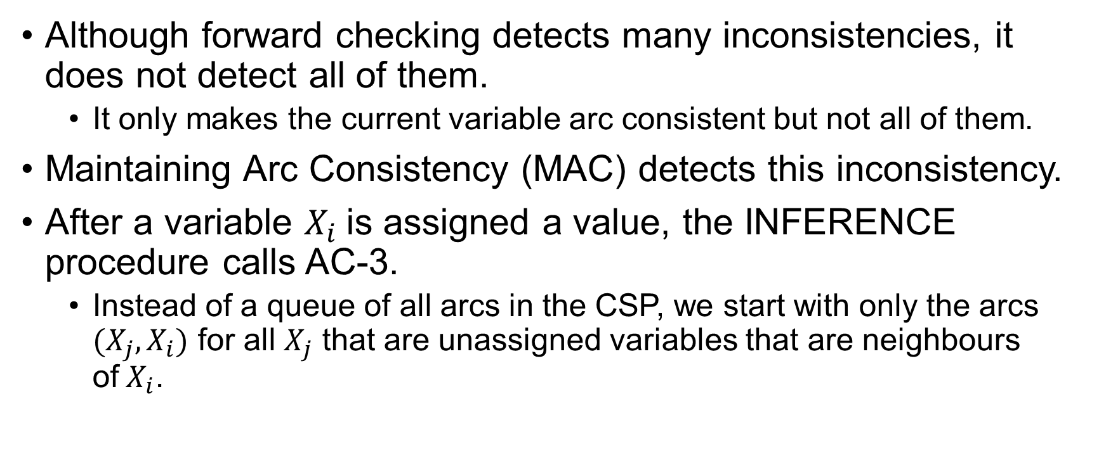
Interleaving search and inference
Although forward checking detects many inconsistencies, it does not detect all of them.
It only makes the current variable arc consistent but not all of them.
Maintaining Arc Consistency (MAC) detects this inconsistency.
After a variable $X_{i}$is assigned a value, the INFERENCE procedure calls AC-3.
Instead of a queue of all arcs in the CSP, we start with only the arcs $(X_{j}, X_{i})$ for all $X_{j}$ that are unassigned variables that are neighbours of$X_{i}$.

Slide 47
Intelligent Backtracking
In the algorithm we have learned, whenever a branch failed we backed up to the preceding variable and tried a different value for it.
This is called chronological backtracking.

Slide 48
Intelligent Backtracking
A more intelligent approach is to backtrack to a variable that might fix the problem.
A variable that was responsible.
We will keep track of a set of assignments.
The backjumping method backtracks to the most recent assignment in the conflict set.
How do we get this set?

Slide 49
Intelligent Backtracking
We don’t need extra works to get the set.

Slide 50
Thank You.

